Slide 1
RFID控制
互動媒體系統整合
徐偉智

Slide 2
Radio Frequency Identification

Slide 3
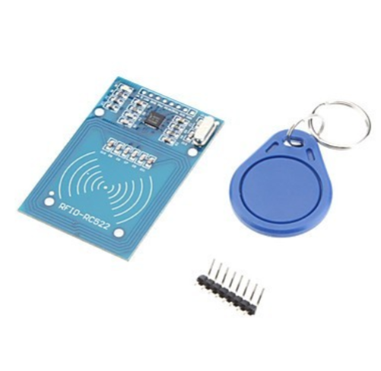
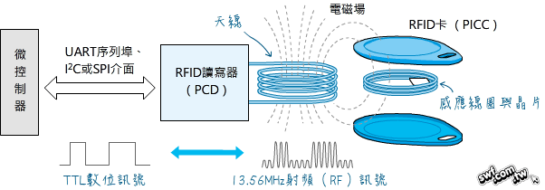
RFID介紹
RFID全稱Radio Frequency Identification，無線射頻辨識。
利用無線電波感應、擷取特定範圍內的RFID標籤訊息。
依不同的標籤與天線型式，會有不同的感應距離及特性。
Ex.門禁卡、高速公路的電子收費「ETC」
https://swf.com.tw/?p=930

Slide 4
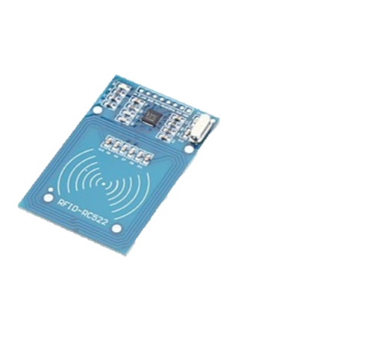
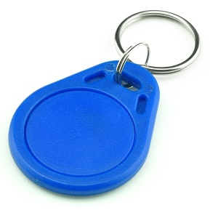
硬體結構
標籤 Tag
讀寫器 RFID Reader

Slide 5


系統結構
應用程式
中介軟體
讀寫器 RFID Reader

Slide 6
Arduino connect with RFID reader

Slide 7
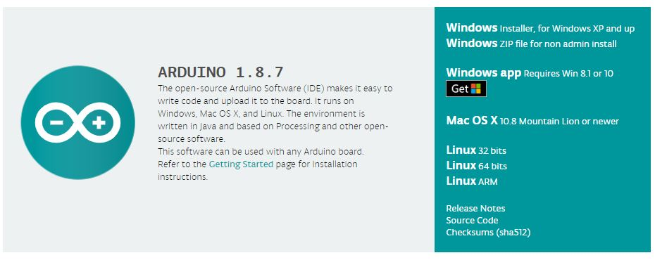
Arduion download
LINK: https://www.arduino.cc/en/Main/Software

Slide 8
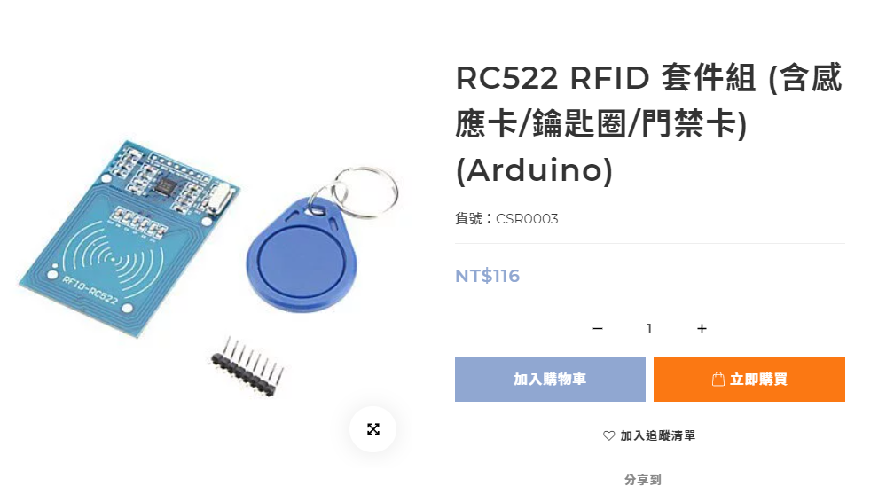
RFID reader
https://shop.playrobot.com/products/rc522-nfc-1356-mhz-kit

Slide 9
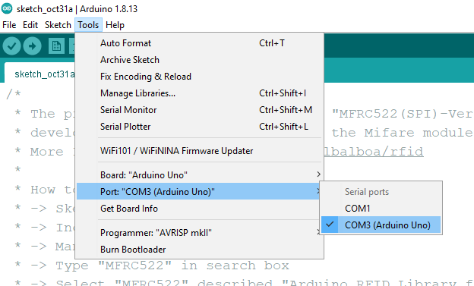
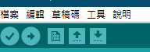
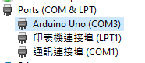
檢測arduino 連接
兩種方法：
1.打開ardunio軟體=>工具=>序列阜
2.於左下角放大鏡搜尋”裝置管理員”
COM3

Slide 10
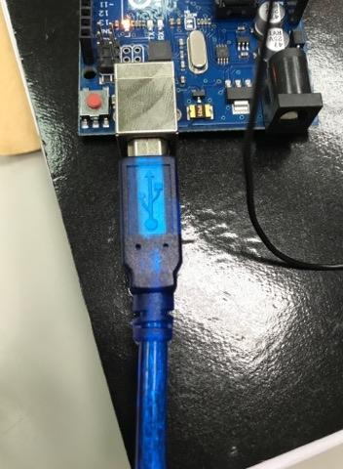
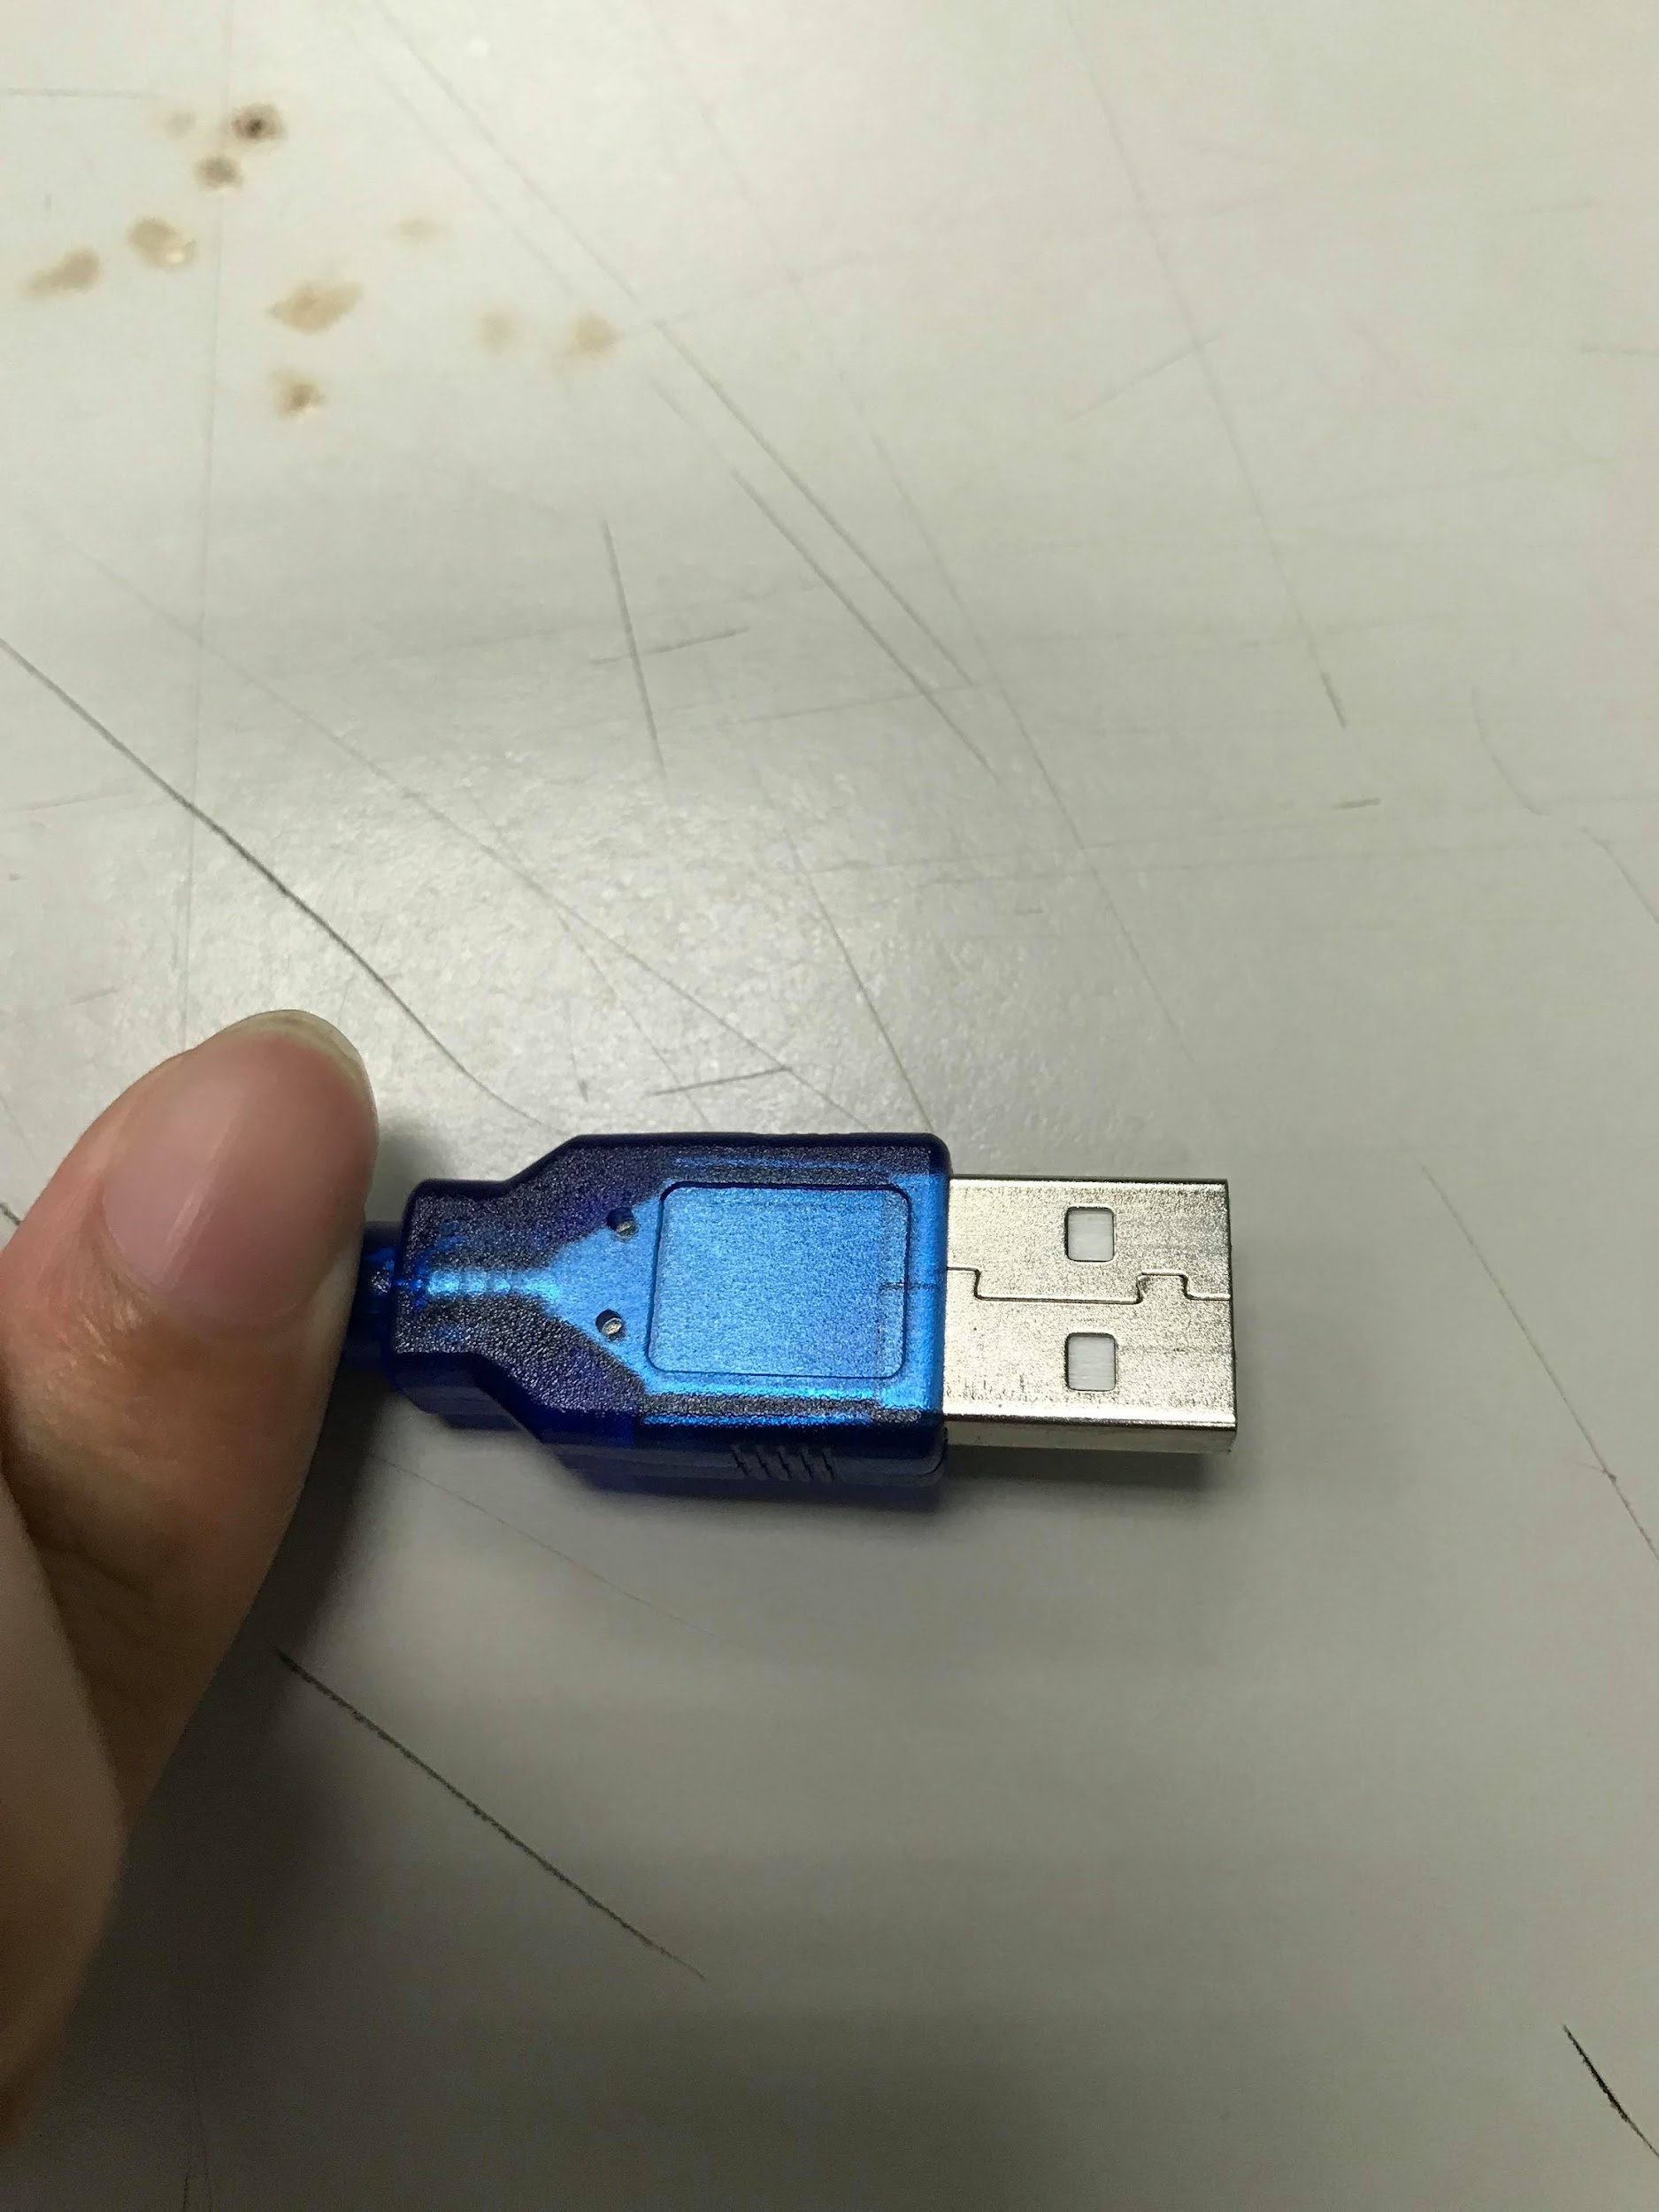
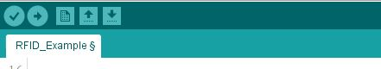
How to connect
Connect Arduino and Commputer with USB and upload code

Slide 11
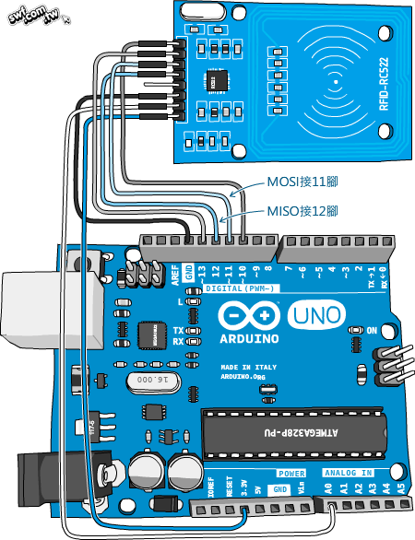
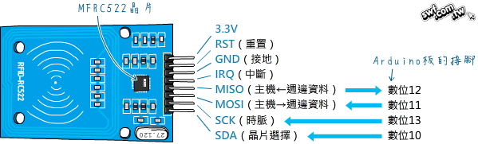
How to connect RFID reader with Arduino
https://swf.com.tw/?p=930

Slide 12
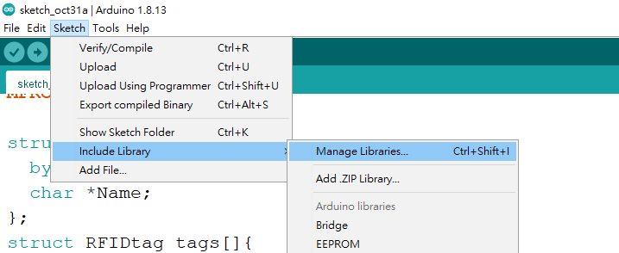
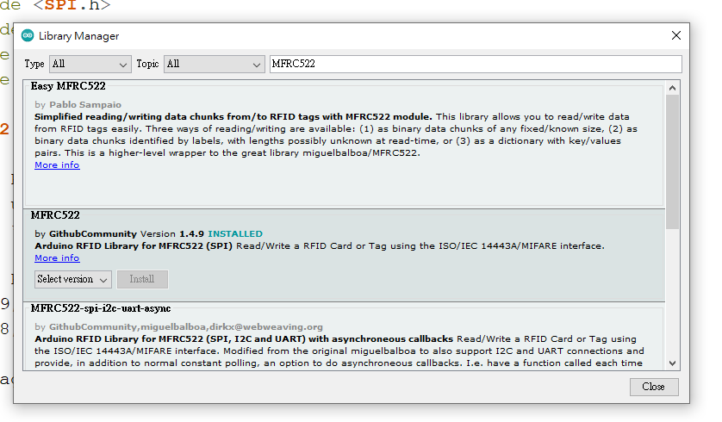
下載MFRC522 函式庫方法(1)
1. Sketech -> Include Library -> Manage Libraries...
2. type "MFRC522 in search box“ -> Install

Slide 13
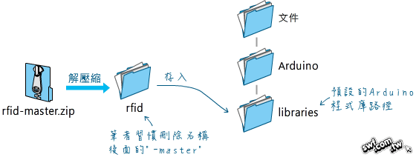
下載MFRC522 函式庫方法(2)
Download link:
https://github.com/miguelbalboa/rfid
https://swf.com.tw/?p=930

Slide 14
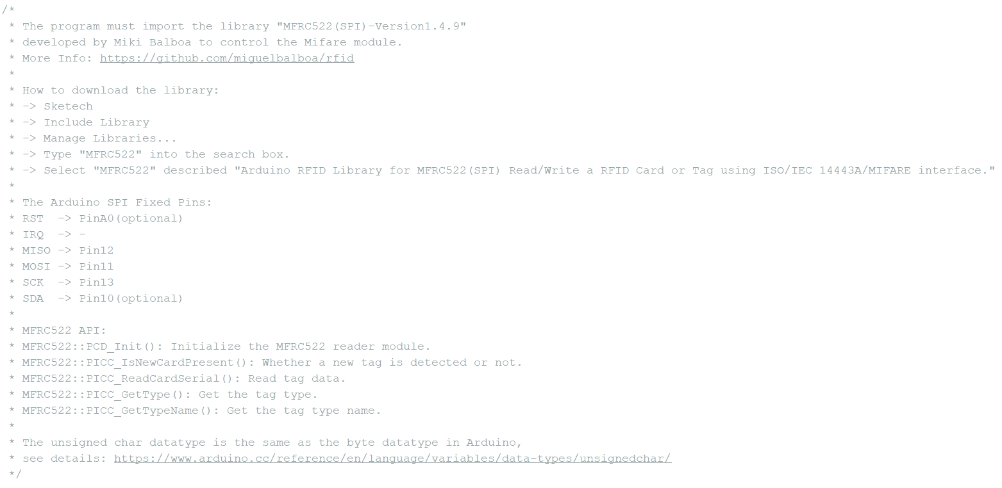
README

Slide 15
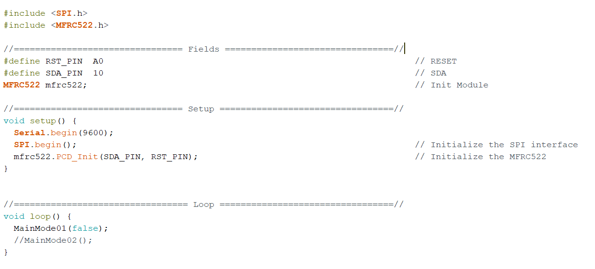
Arduion codes (1/2)

Slide 16
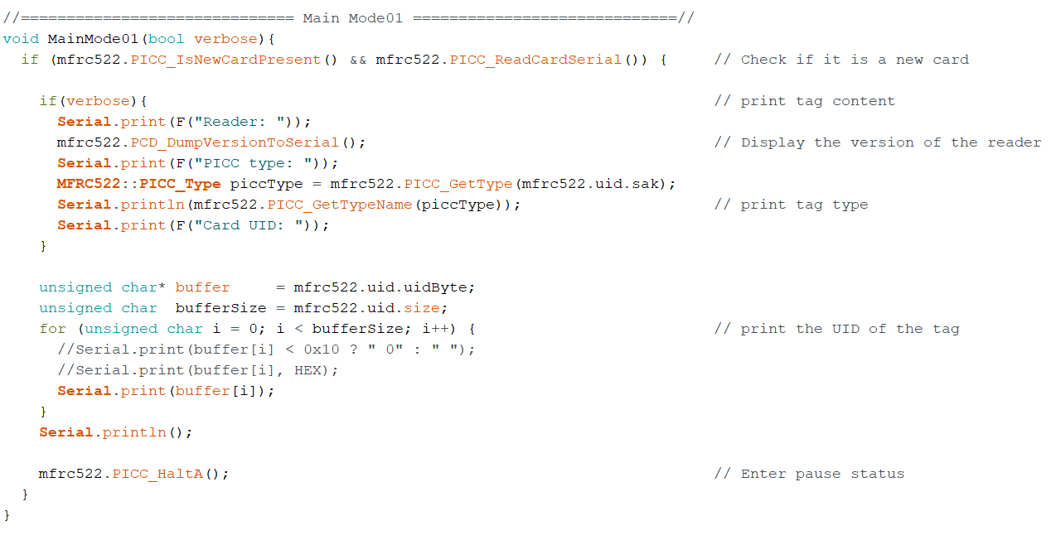
Arduion codes (1/2)

Slide 17
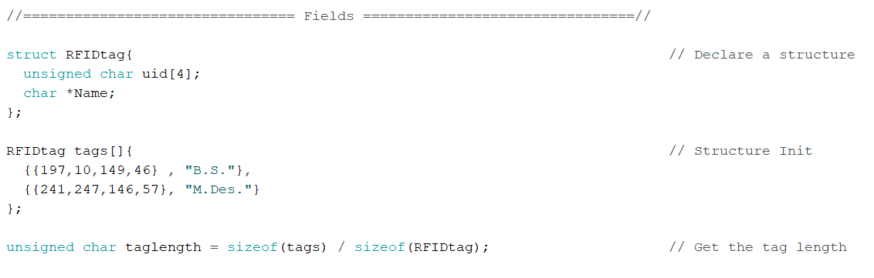
Arduion codes (2/2)

Slide 18
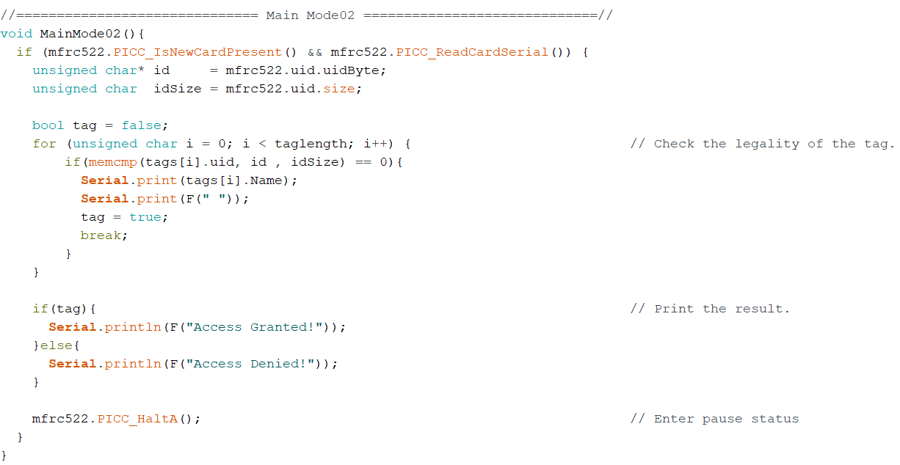
Arduion codes (2/2)

Slide 19
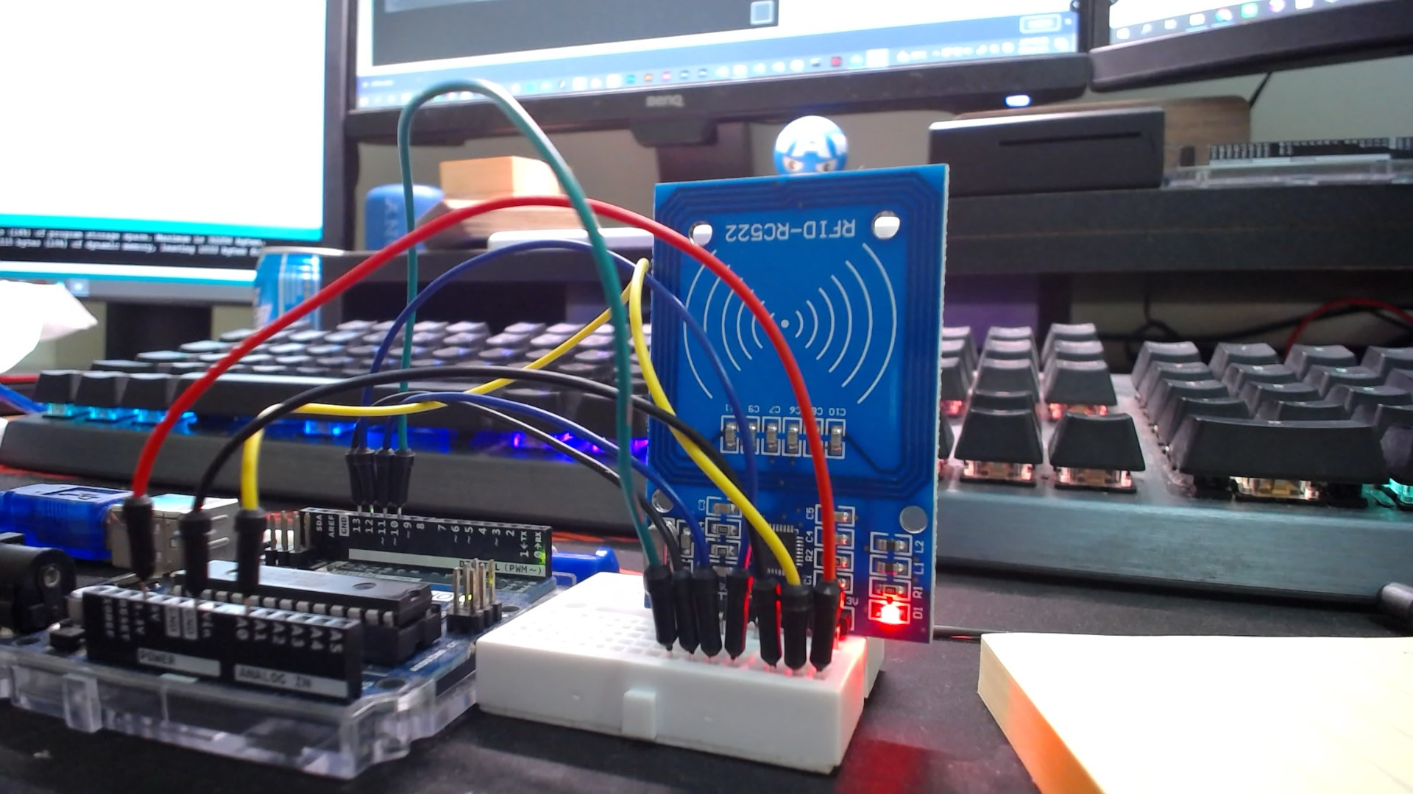
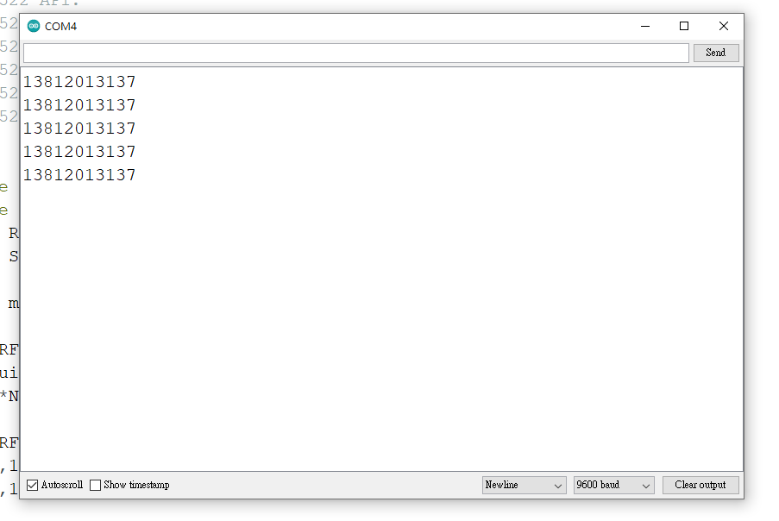
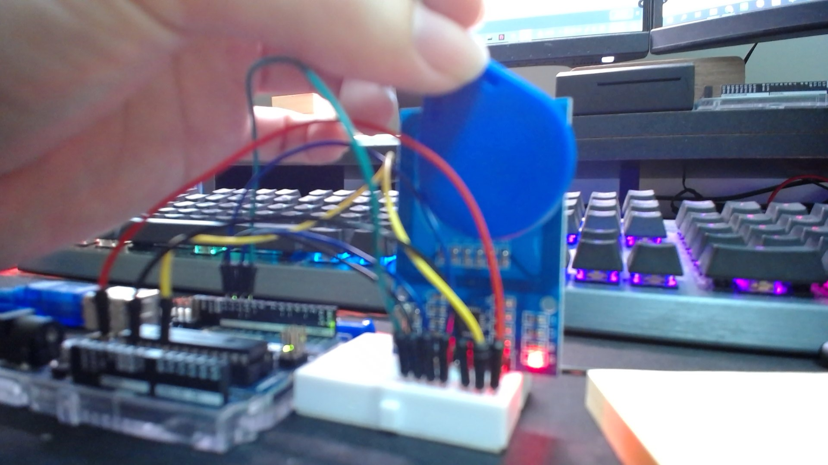
How to connect
1
2
Tag number
3
9600

Slide 20
Apply in Unity

Slide 21
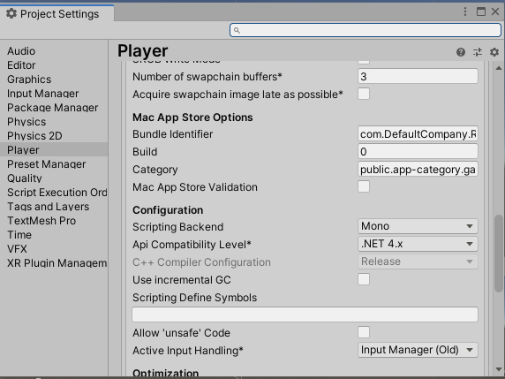
Apply in Unity
Project Setting => Player => Api Comatibility Level =>.Net4.x

Slide 22
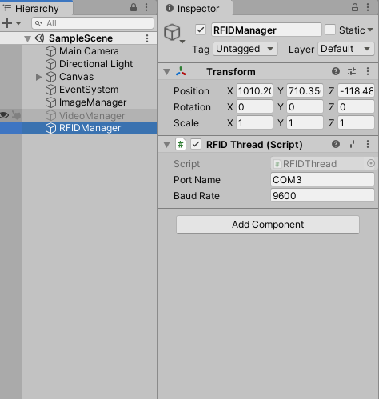
Apply in Unity
Port name
BaudRate
Create an empty GameObject named “RFIDManager” and add the “RFIDThead.cs(Script)” component to it.

Slide 23
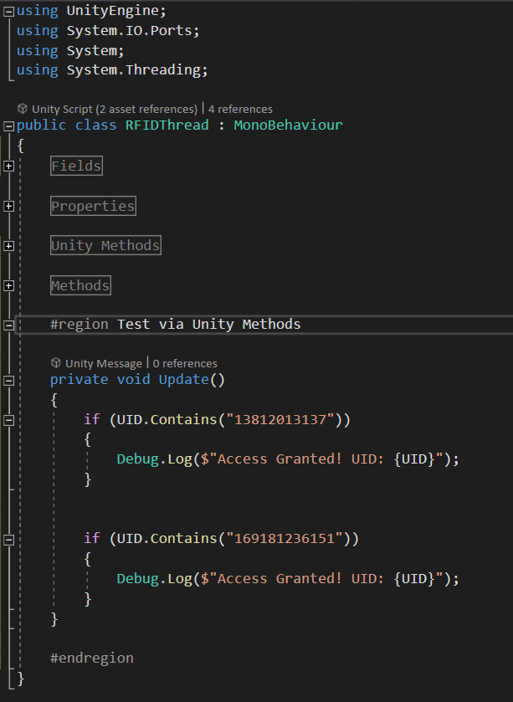
Apply in Unity
“13812013137”
The first Tag
“169181236151”
The second Tag

Slide 24
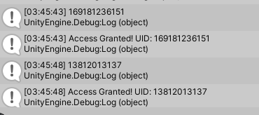
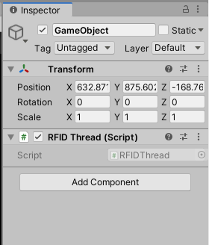
Apply in Unity
It will show Access Granted! UID: 13812013137“

Slide 25
RFID 控制影片
主要功能：當RFID靠近時撥放影片，離開時暫停

Slide 26
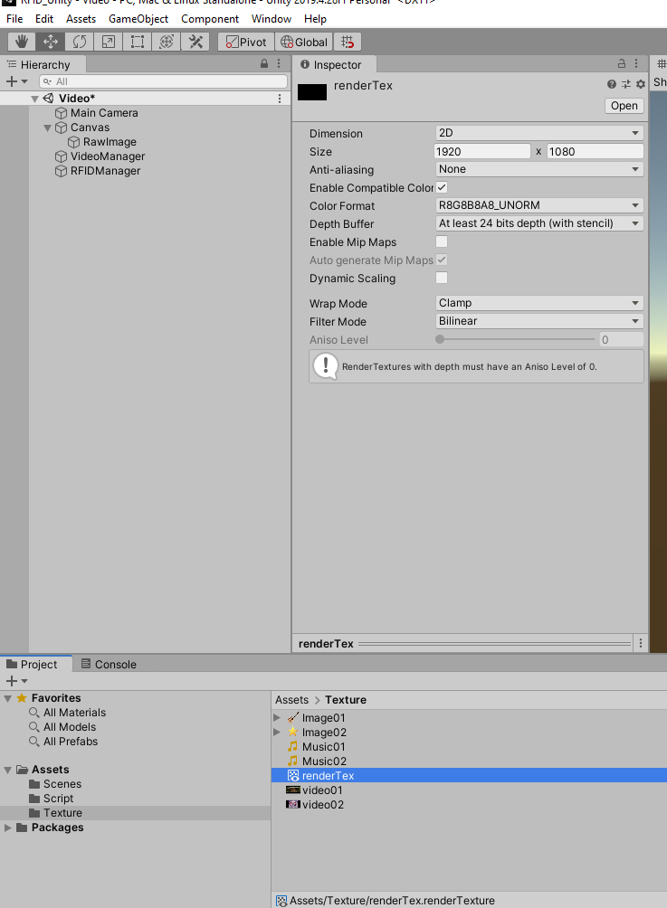
RFID 控制影片(1/4)
create a Render Texture fIle.
=> rename “renderTex”
According your display resolution to
Set the size of renderTex according to the
resolution of your monitor. Usually, we set it to
1920 X1080.
2
1

Slide 27
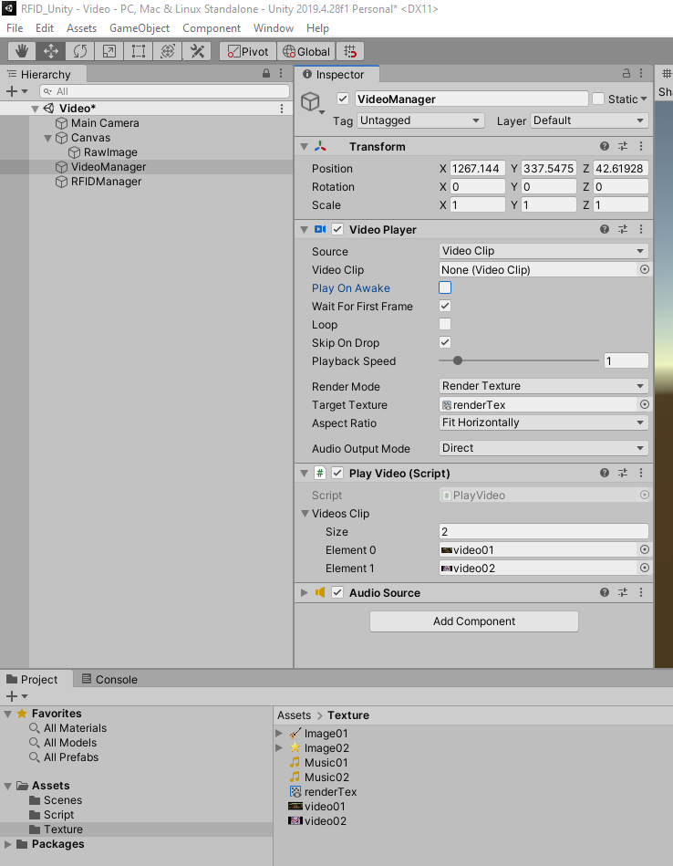
RFID 控制影片(2/4)
Create empty GameObject
rename “VideoManager”
add Video Player component
Cancel “play On Awake”
Add “PlayVideo.cs (Script)” component to it.
Set the size of videoclip to 2 and drag your video to it.
Drag the renderTex you just created
to the Target Texture.
1
2
3
5
4

Slide 28
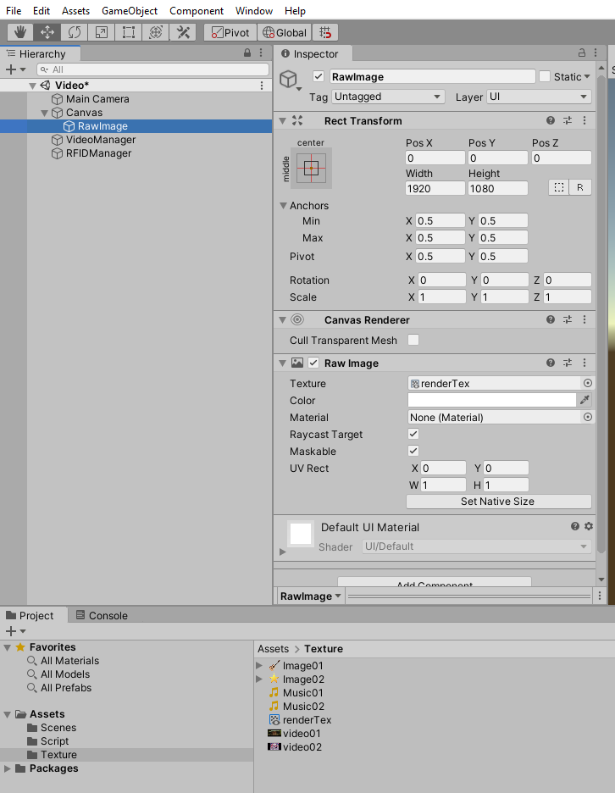
RFID 控制影片(3/4)
Create the Raw Image GameOnbject.
Right click -> UI -> Raw Image
Drag the renderTex to the Texture.
Set the size and position of the RawImage
to the same value as show on the right.
1
3
2

Slide 29
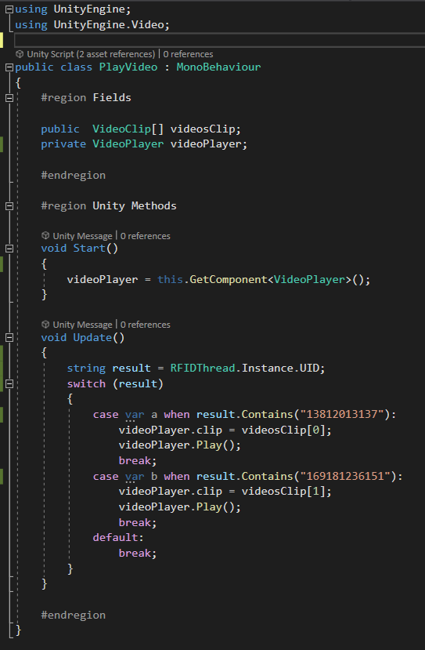
RFID 控制影片(4/4)
Must be modified to your own tag.

Slide 30
課堂作業
功能：
當讀取不同RFID的時候，會更換成不同圖片以及聲音。

Slide 31
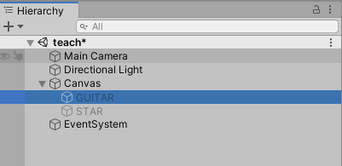
Apply in Unity
1.於Hierarchy中右鍵 => UI =>新增兩個Image並改名

Slide 32
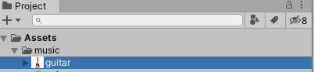
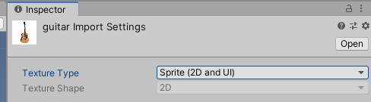
Apply in Unity
2.點擊新增的圖片並更改Texture Type =>
Sprite(2D and UI)

Slide 33
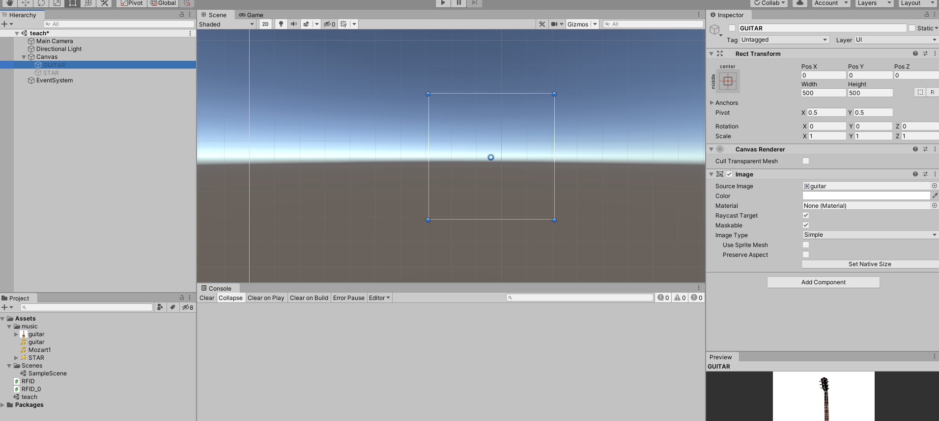
Apply in Unity
3.拖拉圖片至指定Image的Soruce Image

Slide 34
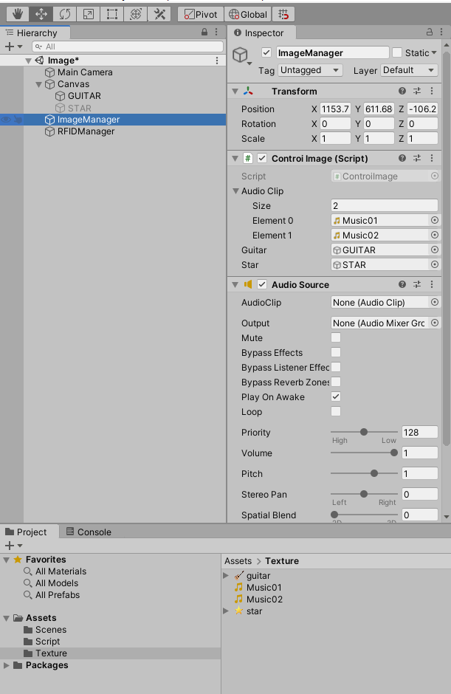
Apply in Unity
4. 創建一個空物件 ImageManager
5. 添加Controlmage 腳本
6. 將Clip設定為2，接著將
指定物件拖拉至程式中
7. 添加 Audio Source

Slide 35
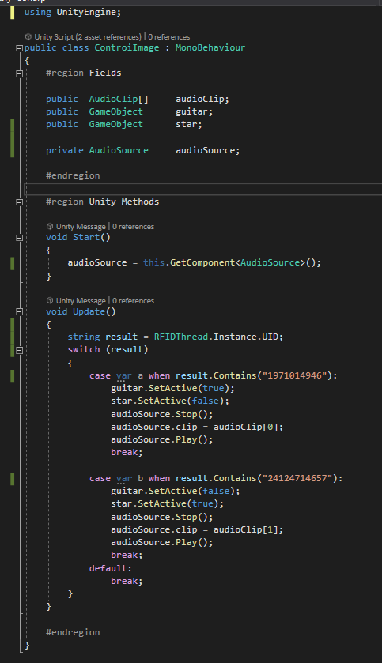
Apply in Unity
改成你自己的Tag

Slide 36
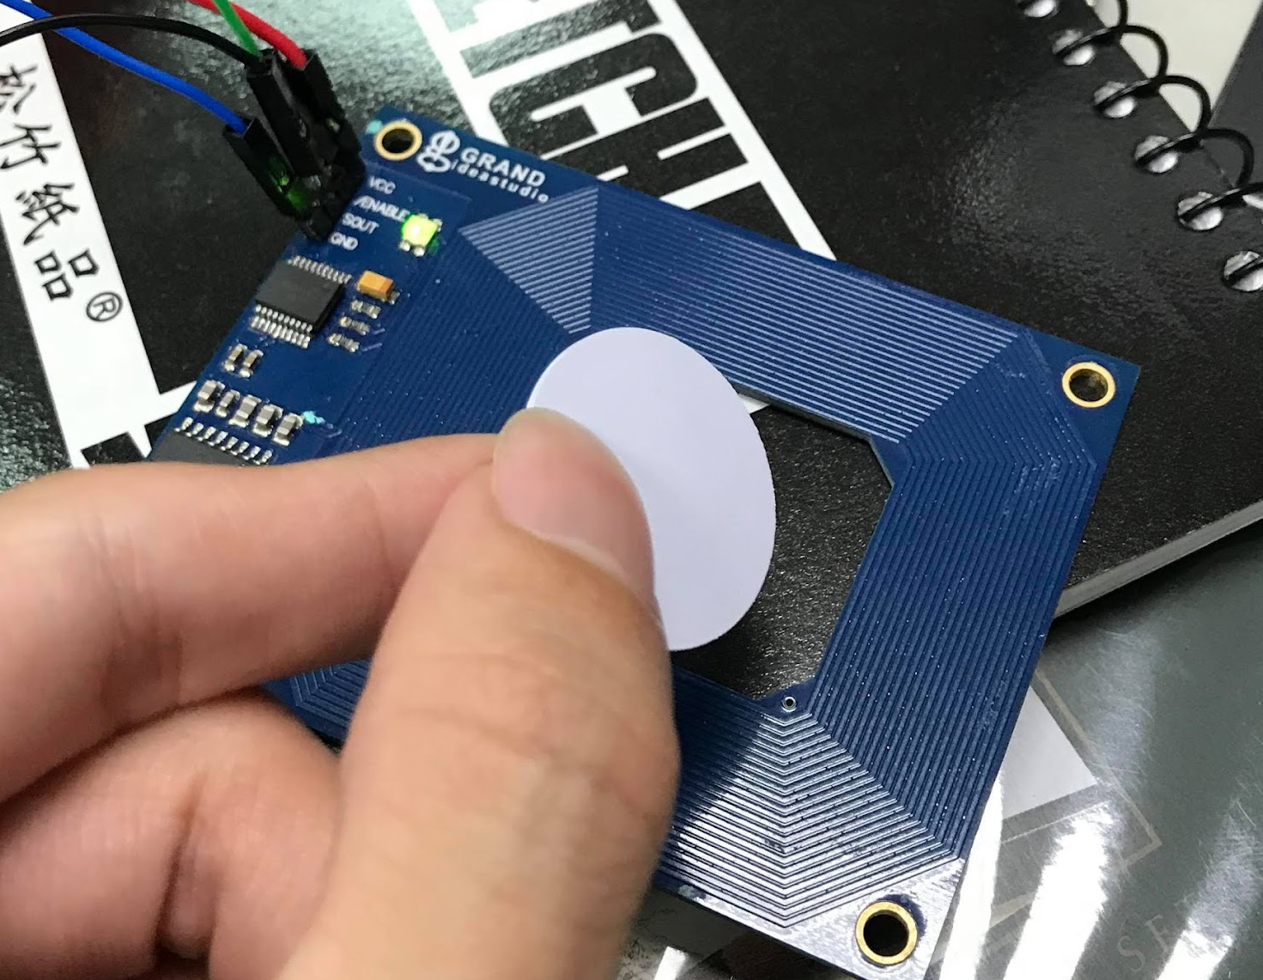
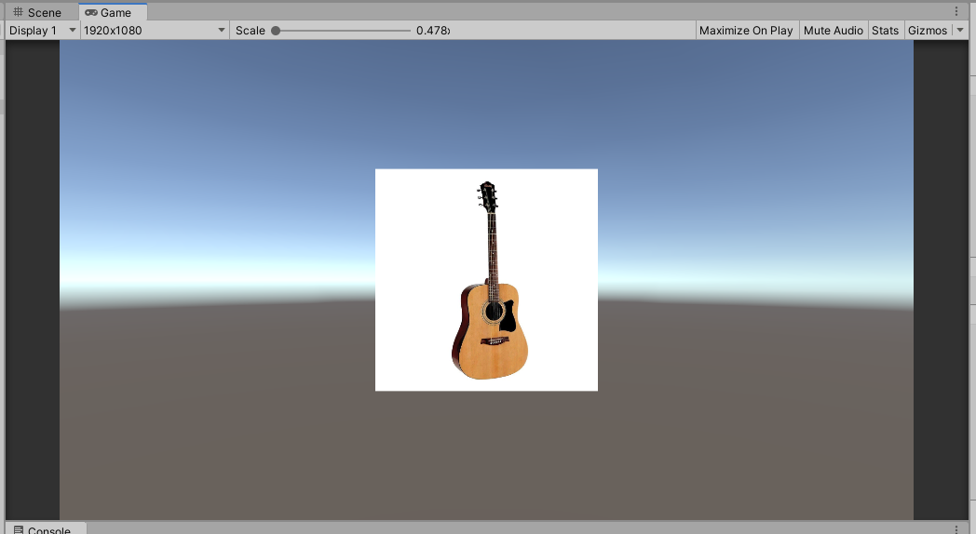
Apply in Unity
執行後感應特定RFID便會出現對應圖片及聲音。

Slide 37
Case studies

Slide 38
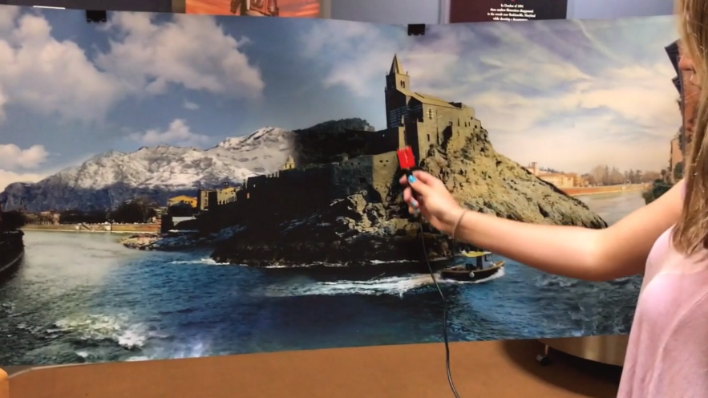
HiFi / 2017
https://vimeo.com/215577026

Slide 39
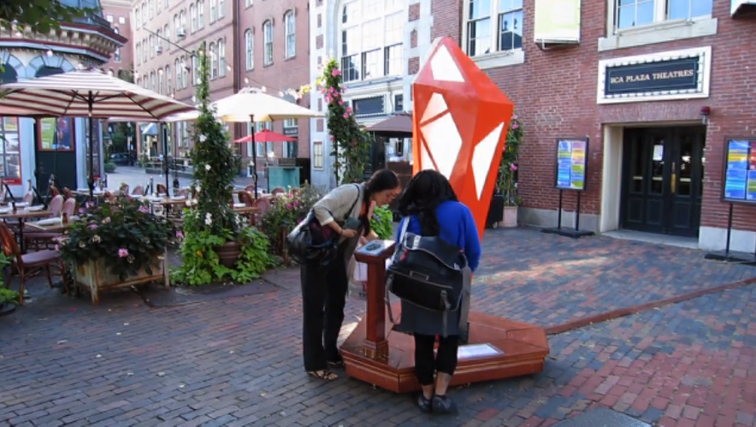
Culture Tap / 2013
https://vimeo.com/76181286

Slide 40
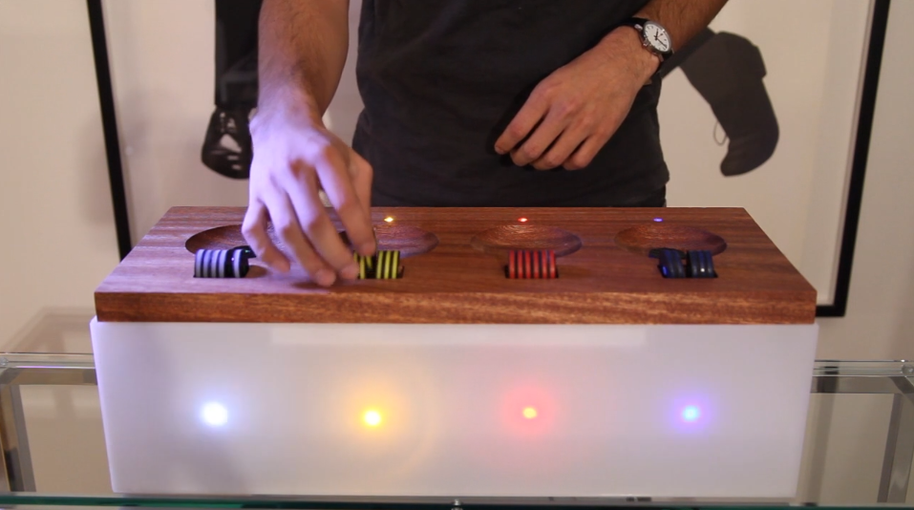
RFID Beat Box / 2011
https://vimeo.com/33581984

